Slide 1


POST INFLUX
INNOVATIVE PRODUCT DEVELOPMENT-II
20RH1A1262
20RH1A1276
20RH1A1296
IT-B

Slide 2
PROBLEM STATEMENT
Information sharing is a major factor for development in the country. It is a time taking process to share information to all the citizens of the country through media and newspaper. In this modern generation almost everyone has a mobile phone in their hand. We can use this opportunity to share information directly to them through SMS or email. This will save time and money and information can be shared with a larger community within short time duration. Also such service can be used to repeatedly send SMS in case of emergency situations.

Slide 3
Gist of ipd-i
Created a standalone application
Through which the organization can send bulk emails
But we used STATIC method
Bulk SMS is not provided in IPD-I Project

Slide 4
Additional features
Bulk emails will be sent in a DYNAMIC way
(i) same mail to the group of email id’s
(ii) different mails to the group of email id’s

Slide 5
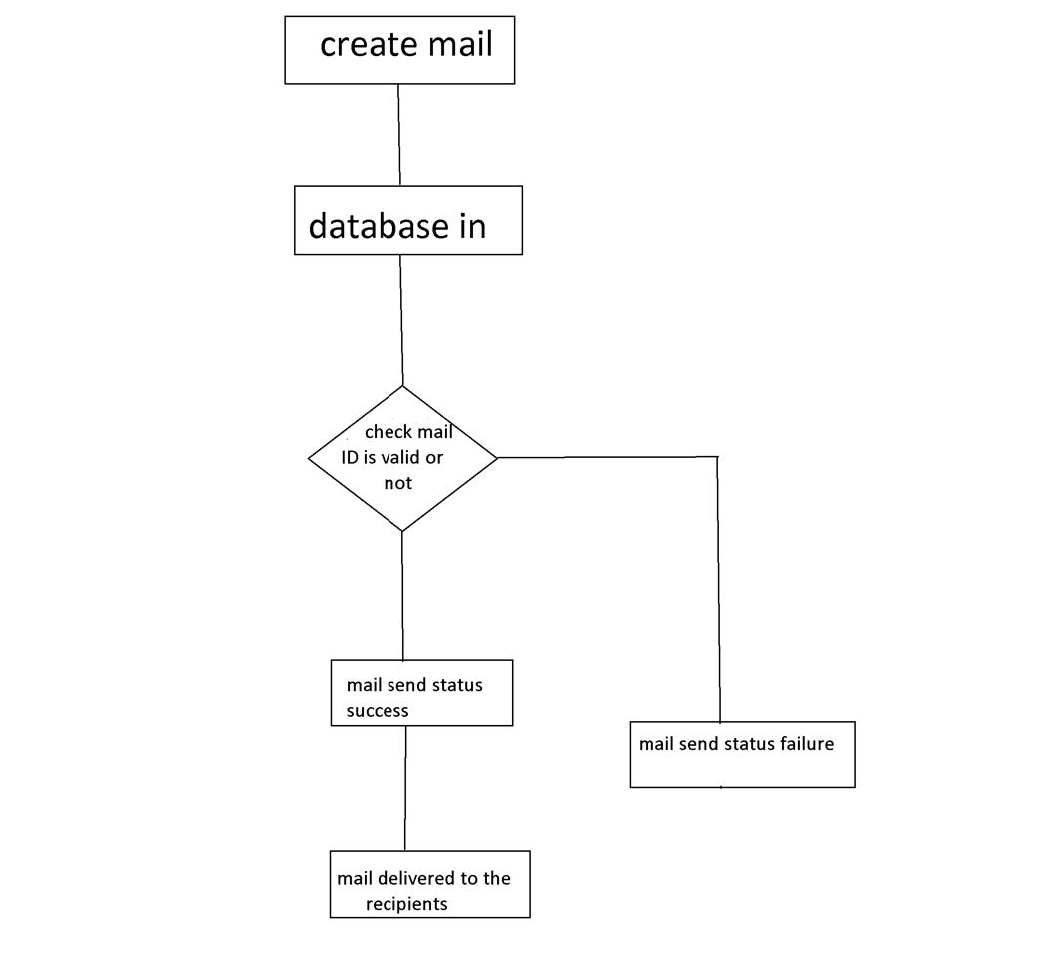
PROTOTYPE

Slide 6
TECH STACK AND PLATFORM ,FRONT/BACK USE
ECLIPSE
JAVA MYSQL
SMTP
http
We are using ECLIPSE platform
JAVA programming (Swing and GUI Application) for the FRONTEND
MYSQL database is used to store the data which acts as BACKEND
SMTP protocol used to send Emails
HTTP protocol used to send SMS

Slide 7
BENEFITS & CONSEQUENCES
No need of using whastapp official groups
No need of logging into ERP bees regularly
It can send mails like vacations, sudden holiday, importance notice regarding events, attendance, sem grade.
Controlled by the organization (Secured)
Portable and convenient to all the students and Staff

Slide 8

At last we want to say that using this website will help us get notified faster and easier and all will get notifications of every important alerts without missing any single mail.
And we can send the information for a group of members at a time using this technique.
CONCLUSION

Slide 9


